Slide 1

Deep API Directive Detection
Kai Zhang，Xiaojian He，Chong Wang

Slide 2


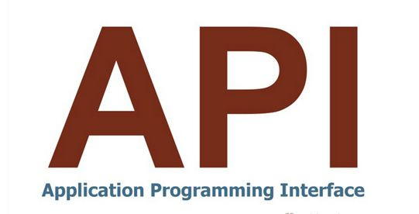
Scenario
Constraints and Restrictions
API directives

Slide 3
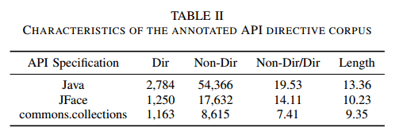
Two Challenge
Class Imbalance Challenge
Multi-Morphologies Challenge
invo*
inherit*
efficien* —→“efficient”, “efficiency”, “efficiencies”

Slide 4
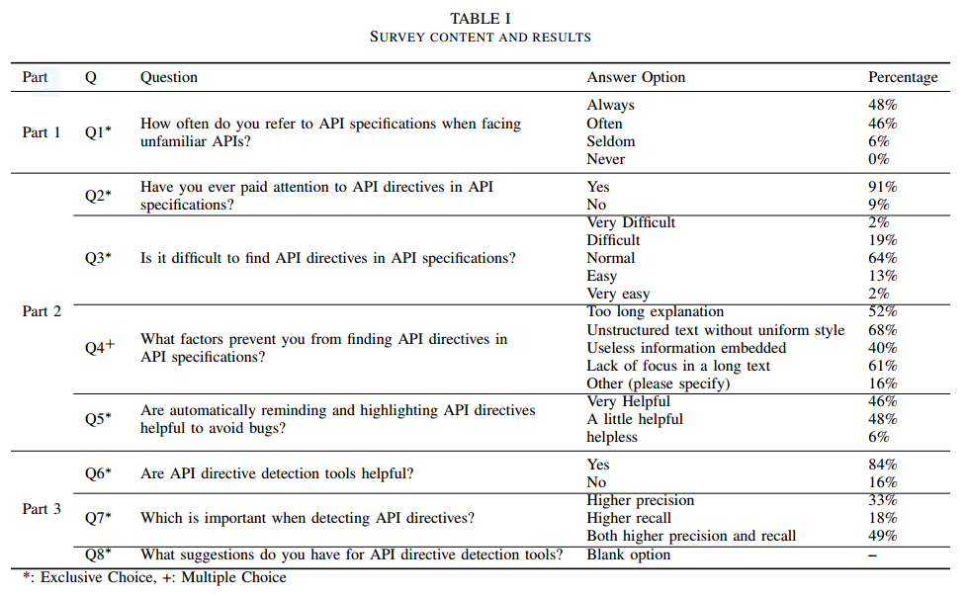
Survey
Aim
Process
Developers’ attitudes towards API specifications
10 developers’ answers → predefined answers
#
1
#
Their reactions to API directives
5,000 Github developers(more than 10 commits to Java projects ) → receive 305 responses in total with a response rate of 6.10%
Their expectations to API directive detection tools
2
#
Notes:
API文档经常被程序员查看参考
API directives 可以使程序员避免出现bug，高亮可以帮助程序员注意到
从文档中找到这些directive不是特别方便

Slide 5
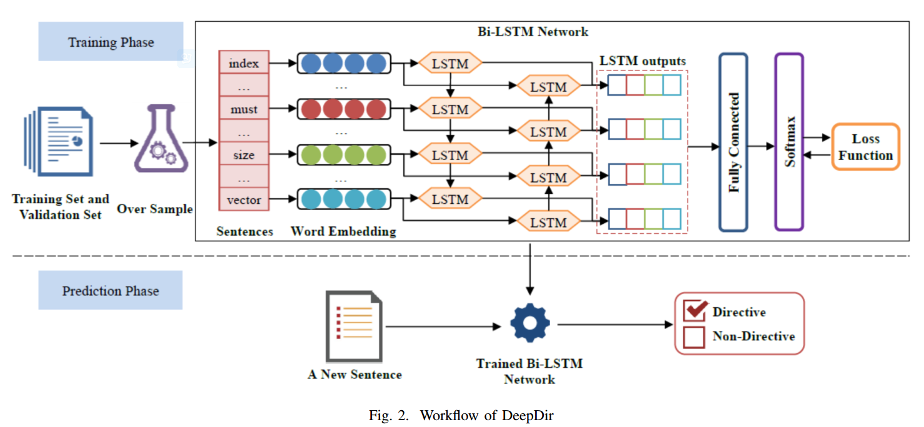
experimented our approach on 47 realistic code search scenarios.
Framework

Slide 6
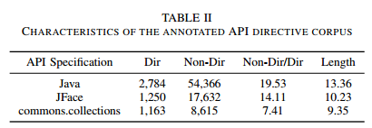
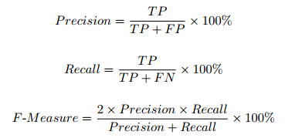
EXPERIMENTAL SETUP
Evaluation Method：
1. Divide each API specification into 10 equally sized folds based on HTML webpages
2. 1 fold testing, the fold before the test set validation set
3. Each fold is selected as the test set once
Baseline Approach ：Monperrus et al. detect API directives based on the bags-of-words assumption

Slide 7
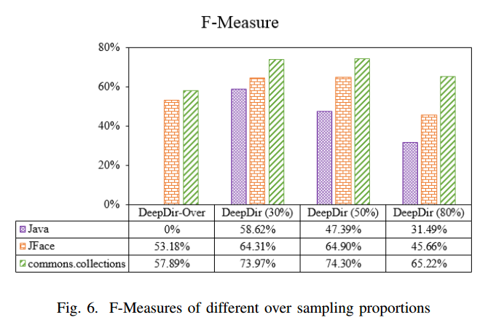
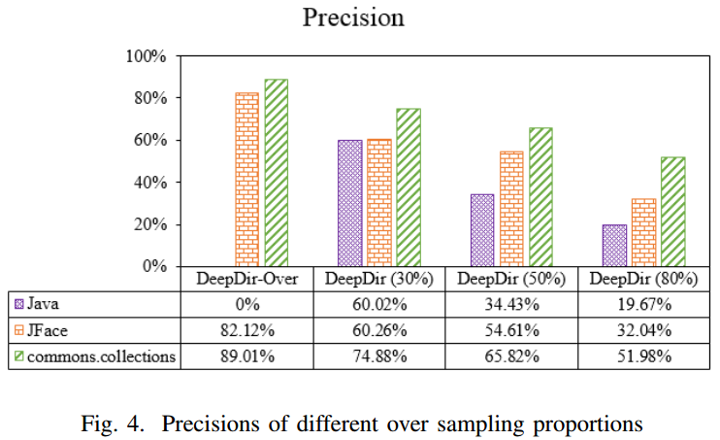
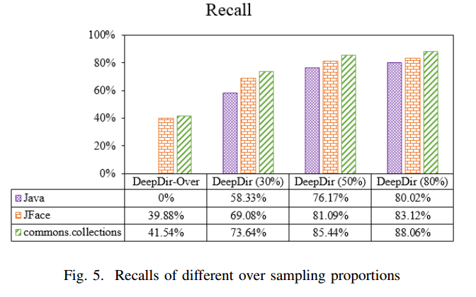
EXPERIMENTAL RESULTS
RQ1: What is the influence of the over sampling proportion on DeepDir?
Conclusion:The over sampling strategy is effective in DeepDir. DeepDir can adapt to different situations by adjusting the over sampling proportion.
Notes:
Over sampling是有效的，参数可以调节

Slide 8
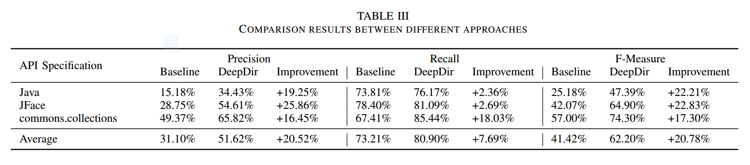
EXPERIMENTAL RESULTS
RQ2: How much improvement can DeepDir achieve against the baseline approach?
Conclusion: Compared against the baseline approach, DeepDir is a more accurate approach to automatically detect API directives in API specifications.
Notes:
更准确

Slide 9
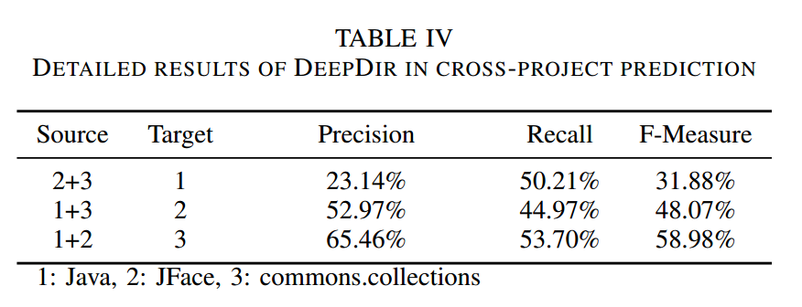
EXPERIMENTAL RESULTS
RQ3: What is the performance of DeepDir when conducting the cross-project prediction?
Conclusion: Even though the cross-project prediction is more difficult, DeepDir still performs well. DeepDir can be used in the real scenarios.
Notes:
跨项目

Slide 10
CONCLUSION
ONE
TWO
THREE
Propose a deep learning based approach, i.e., DeepDir, to automatically detect API directives
DeepDir significantly improves the state-of-the-art approach by up to 22.83% in terms of F-Measure
DeepDir captures common semantic characteristics of API directives across different API specification
Notes:
1.实现工具 2.比现有技术好 3.语义信息

Slide 11
FUTURE WORK
01
02
Consider the suggestions made by developers in the survey
Evaluate DeepDir over more annotated API directive corpora
Notes:
1.Survey中的建议 2.更多的API 标注directive

Slide 12
THANKS

